Slide 1
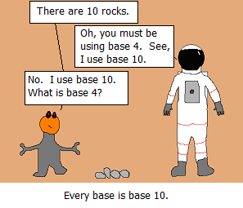

Slide 2
Binary
Computers represent everything as bits
Recall: a byte is 8 bits
Int: 4 bytes (32 bits)
What’s the largest int we can represent?
2^32 - 1
(unsigned)

Slide 3
Binary
Computers represent everything as bits
Recall: a byte is 8 bits
Int: 4 bytes (32 bits)
What’s the largest int we can represent?
2^32 - 1
(unsigned)

Slide 4
Binary
Computers represent everything as bits
Recall: a byte is 8 bits
Int: 4 bytes (32 bits)
What’s the largest int we can represent?
2^32 - 1
(unsigned)

Slide 5
Hexadecimal (base 16)
Binary takes up a lot of space
Hexadecimal takes few digits but can easily be converted to binary (and vice versa)
Hex uses digits 0-9 and a-f
1 hex digit = 4 bits
0000 0000 0000 0001 1101 0011 0101 1011
1d35b

Slide 6
In C
Format ints
%d for decimal
%b for binary
%x for hex
Assign ints
0b for binary (ex: 0b11011 is 27)
0x for hex (ex: 0x83fa9 is 540585)

Slide 7
Bitwise Operators
You know logical operators…&&,||,!
We will now learn &,|,~,^,<<,>>
These operate at the bit level

Slide 8
&
a | b | a & b
1 | 1 | 1
1 | 0 | 0
0 | 1 | 0
0 | 0 | 0

Slide 9
|
a | b | a | b
1 | 1 | 1
1 | 0 | 1
0 | 1 | 1
0 | 0 | 0

Slide 10
^
a | b | a ^ b
1 | 1 | 0
1 | 0 | 1
0 | 1 | 1
0 | 0 | 0

Slide 11
^
a | ~a
1 | 0
0 | 1

Slide 12
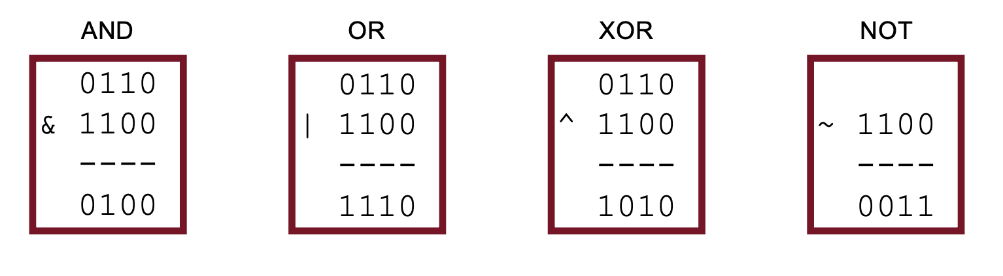
Operators on multiple bits

Slide 14
Bitmasks
We often want to manipulate or isolate specific bits from a collection
A bitmask is a bit pattern that achieves this
We can use and/or create bitmasks using bitwise operators

Slide 15
Example: CSCI courses
Array of ints vs. storing bits

Slide 16
Example: CSCI courses
Array of ints vs. storing bits
Bitmasks
Setting bits to 1 with |
Setting bits to 0 with &
Computing union and intersection
”Masking off” unwanted bits
But how do we mask an arbitrary position?

Slide 17
<< and >>
x << k shifts x left by k
00110111 << 2 results in 11011100
01100011 << 4 results in 00110000
10010101 << 4 results in 01010000
x >> k shifts x right by k
Careful with unsigned ints for >>

Slide 18
